Slide 1
The DBICP Project http://code.google.com/p/dbicp
April 2009
Jean-Baptiste Fiot

Slide 2
Position of the problem
Point-based registration
Parametric transformations
Unknown correspondences
Conditions might be tough. Example:

Slide 3
ICP algorithm
Initialization
  Initial transformation
Iterations of 2 steps:
  Matching step
    Find the correspondences given the current transformation T
  Optimization step
    Optimize the parameters of the transformation T given the current correspondences

Slide 4
ICP – Matching Step
Illustrated with the blue arrows:

Slide 5
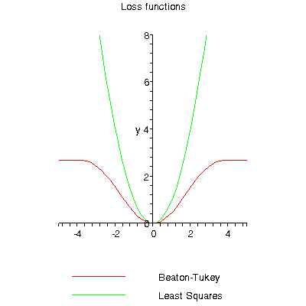
ICP – Optimization Step

Slide 6
ICP – Optimization Step
Various possibilities (IRLS, Levenberg Marquadt, classic gradient descent...)
Gradient descent with ρ constant, using finite differences:

Slide 7
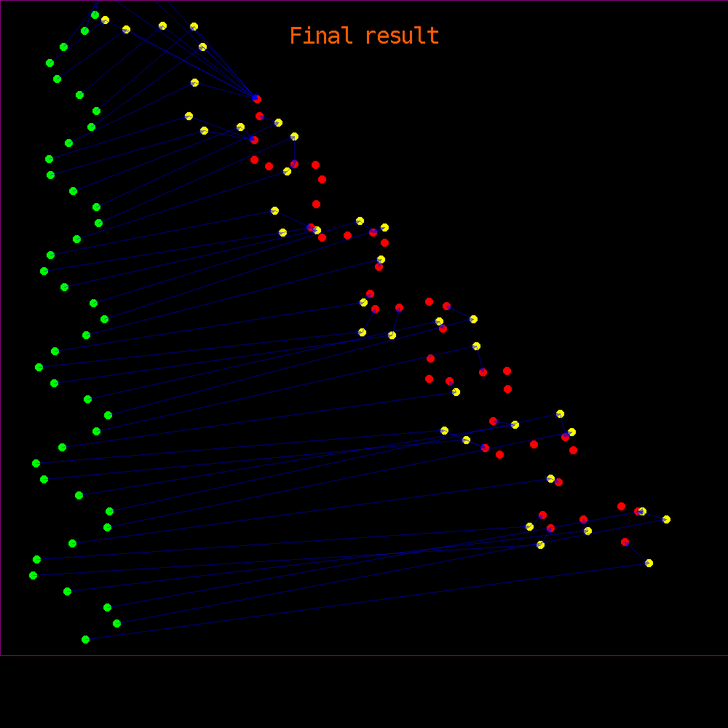
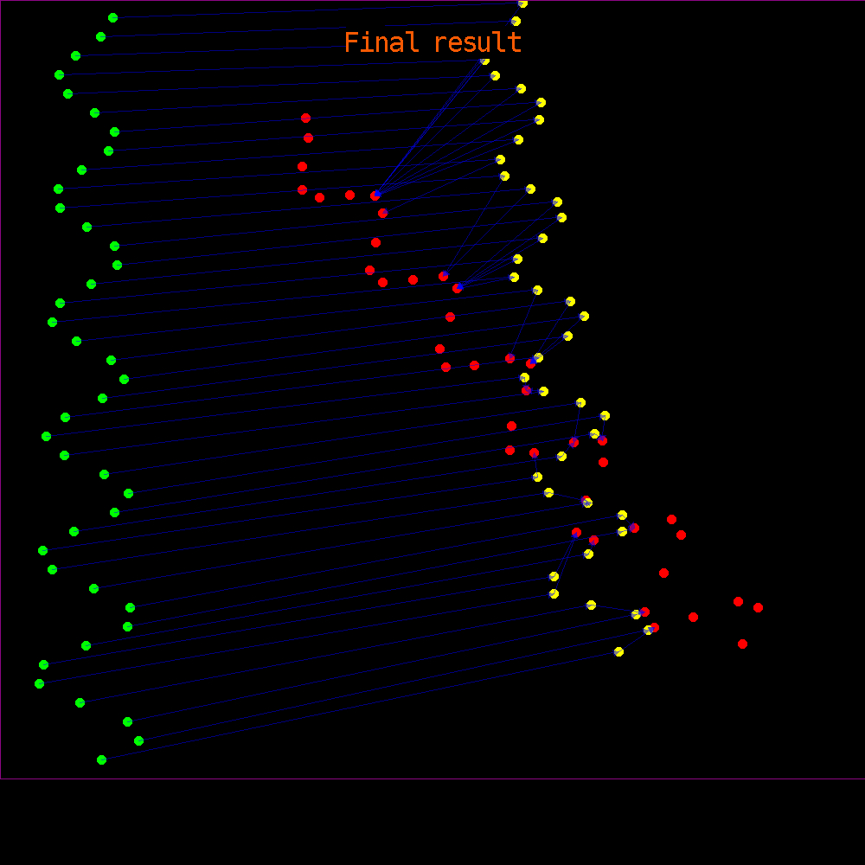
ICP Demo
Videos of algo stuck in local minima:
  Video 1 Video 2

Slide 8
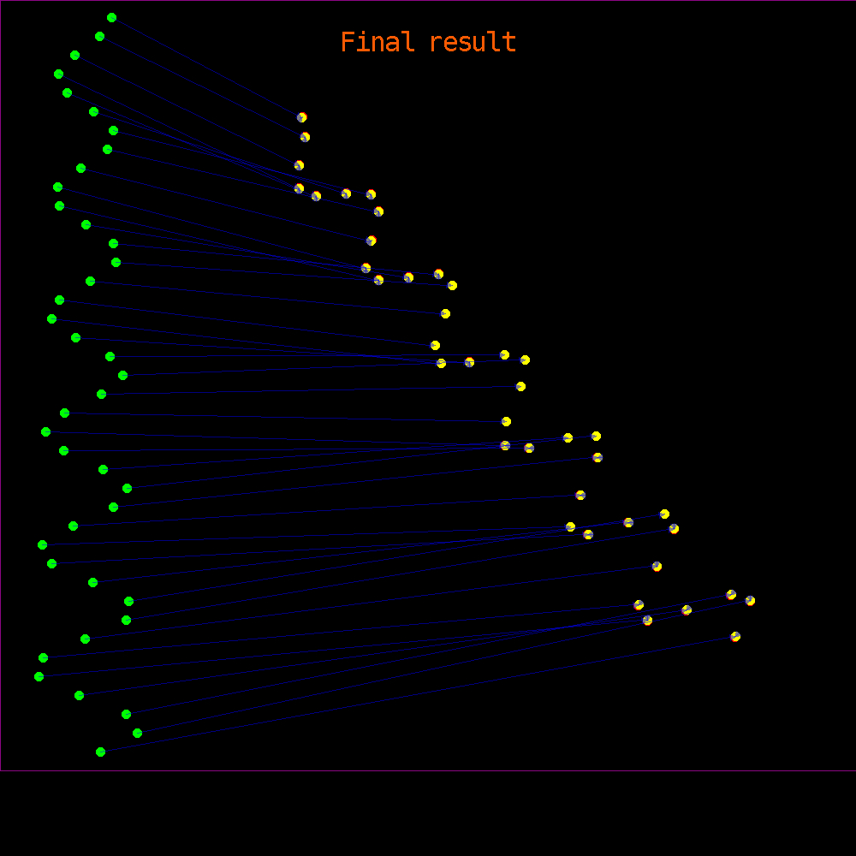
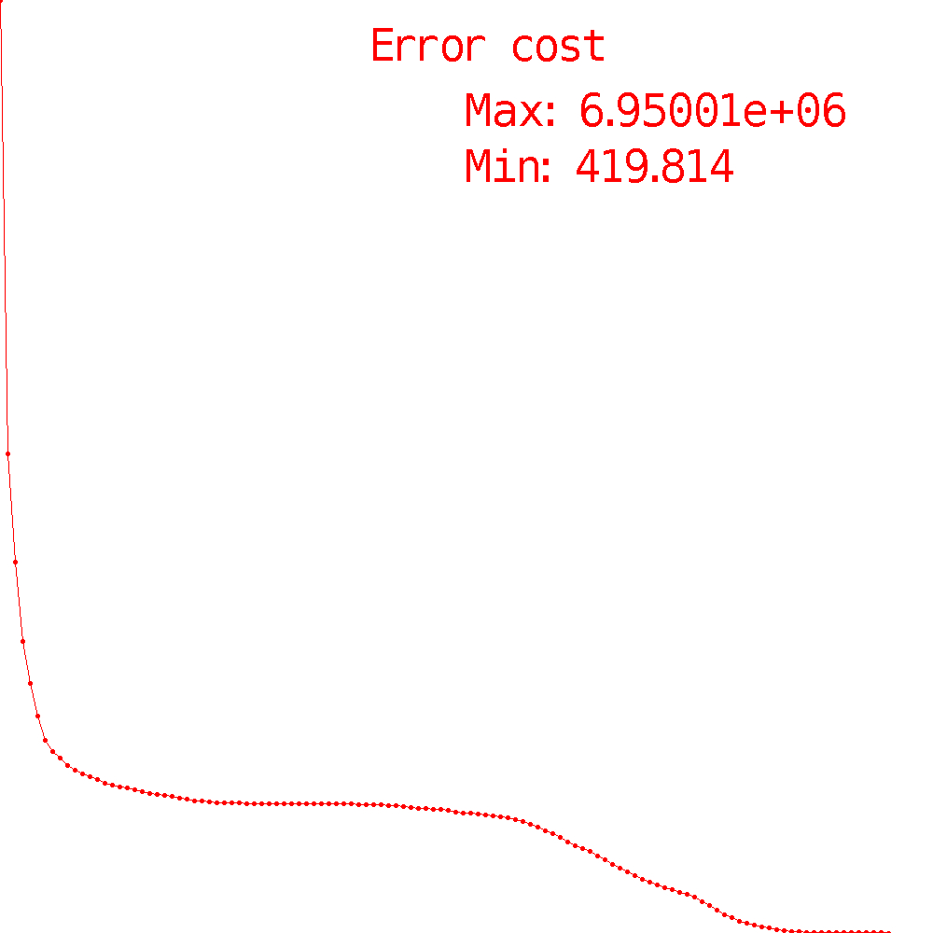
ICP Demo
Video of a successfull result

Slide 9
Conclusion on ICP
Often stuck in a local minimum
Very sensitive to initialization
  Many papers on this issue
Needs a large enough overlap
Sensitive to outliers

Slide 10
Dual Bootstrap ICP
Innovations in the structure
Idea: Approximate the solution in a simpler case (relaxation), then refine it
Goal: avoid being stuck in a local minimum
Dual bootstrap: progressive enlargement of:
  Bootstrap Region
  Parametric Transformation Model

Slide 11
DBICP

Slide 12
Algorithm outline
Initialization
  Bootstrap region
  Initial transformation
Iterations:
  Compute correspondences
  Optimize the transformation
  Bootstrap the region
  Bootstrap the model

Slide 13
Region Bootstrap
Change based on the covariance matrix of the error, and thresholded with a max growth parameter

Slide 14
Model Bootstrap
Transformation | Matrix | DoF
Similarity |  | 4
Affine (not used) |  | 6
Reduced Quadratic |  | 6
Quadratic |  | 12
Selection criterion based on the error and the degree of freedom (DoF)

Slide 15
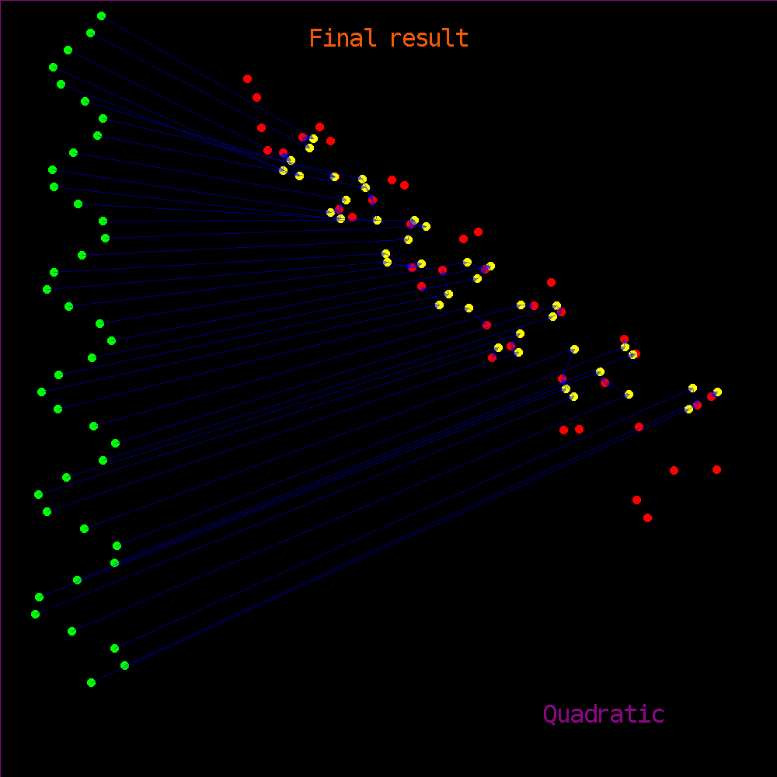
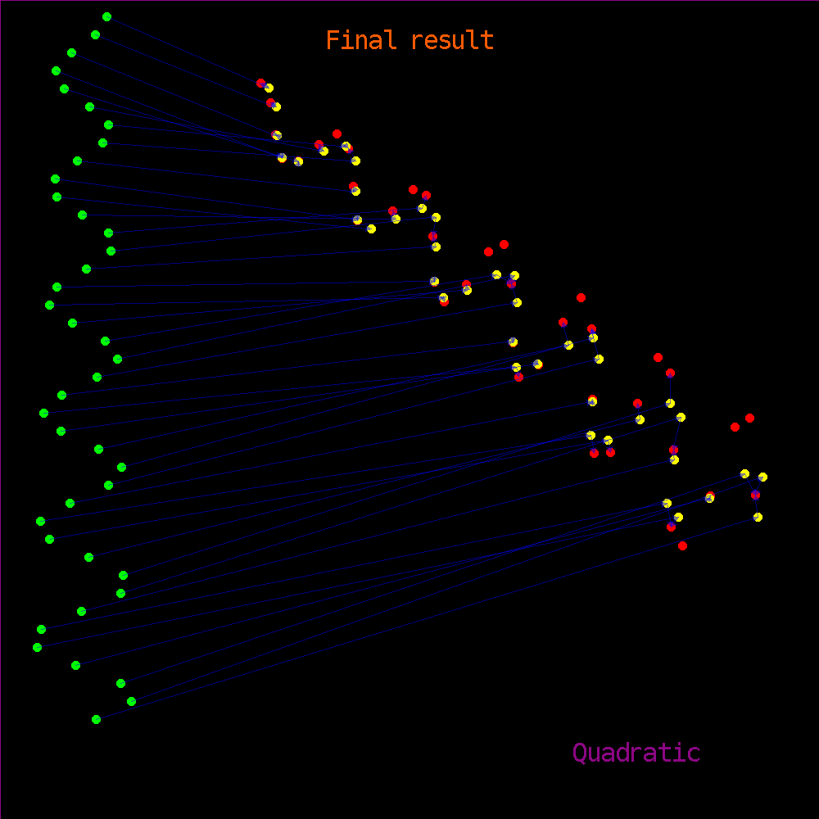
Model Bootstrap Demo
2 videos:
Without MB With MB

Slide 16
Further work
Test on real data (eg human retina registration)
Test with descriptors (not only points' positions)
Test with other optimization techniques (Levenberg Marquardt, …)
Test with other loss functions

Slide 17
Conclusion
Great concept
Efficient and flexible C++ implementation
Mild enthusiasm with the results
Source code available at http://code.google.com/p/dbicp

